Slide 1
OS Architecture
and System Calls
Instructor: William Zheng
Email: william.zheng@digipen.edu
PHONE EXT: 1745
Notes:
1

Slide 2
A word about the study of OS
Generalist versus Specialist
Organic and circularity

Slide 3
Goals of this lecture
System Calls
Interface between user program and OS
OS architecture
Organization and Design of OS code
Notes:
System call is a request by the kernel to enter kernel mode to access a resource while a function call is a request made by a program to perform a specific task.
Context switching occurs in system calls, while there is no context switching in function calls

Slide 4
What is an OS and what are the roles of OS?
Process Management
A process a running program.
Starting, terminating processes
Coordinating processes (allowing processes to talk to one another, protecting them from one another)
Memory Management
Allocation of memory for the processes
Protect memory from being written by another process
How to handle when we run out of RAM
I/O Management
Device drivers
Providing API for the user programs (encapsulation principle)
Storage Management
File systems and data
Notes:
API – application program interface. A concept in software technology that essentially refers to how multiple applications can interact with and obtain data from one another.

Slide 5
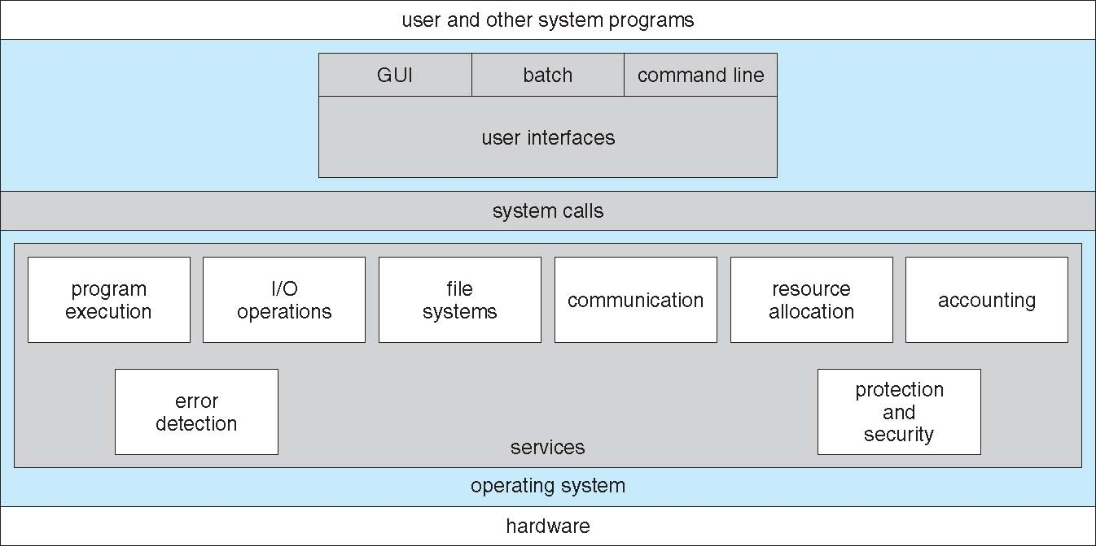
OS Services

Slide 6
Invoking the OS services
int instruction
Generate the software interrupt
int 80h
80h: the interrupt vector for system call
Return: iret
sysenter/sysexit instruction
syscall instruction
Main:
…
call FUNC
…
ret
FUNC:
…
…call the OS. How?
…
ret

Slide 7
System calls
API provided by OS
For access to services provided by OS
How to access?
software-generated interrupt (usually)
call instruction (older days)

Slide 8
Types of system calls
Control
Process – CreateProcess(), ExitProcess(), WaitForSingleObject()
Files – CreateFile(), ReadFile(), WriteFile(), CloseHandle()
Devices – SetConsoleMode(), ReadConsole(),WriteConsole()
Info – GetCurrentProcessID(), Sleep(), SetTimer()
Communications – CreatePipe(), CreateFileMapping(), MapViewOfFile()
Protection – SetFileSecurity(), InitializeSecurityDescriptor()

Slide 9
System call example
Copy contents of file A to file B
How many system calls involved?

Slide 10
Difference between system call and function call
System call: a call into kernel code, typically performed by executing an interrupt
Function call, if calling a system call (via library), switches into kernel mode from user mode

Slide 11
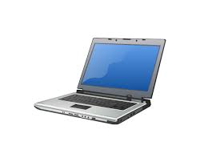
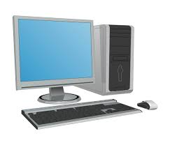
Portability - I
Program X
Program X
Computer
System A
Computer
System B

Slide 12
Portability - II
Binary level
Source code level

Slide 13
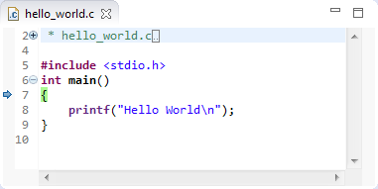


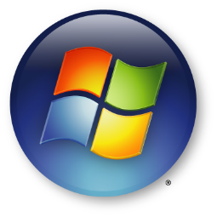
Source Code Portability - Demo
cl

Slide 14
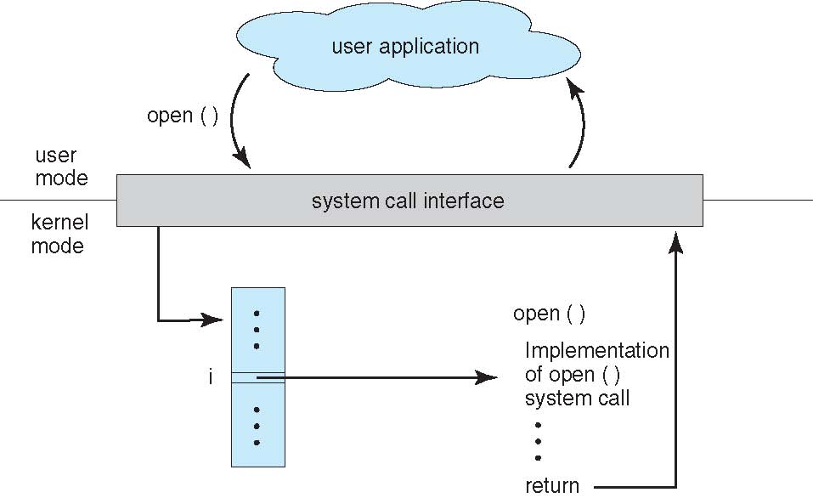
System calls, API and portability
#include <stdio.h>
int main ()
{
int fd = fopen("test.txt", O_WRONLY,0640);
…
}

Slide 15
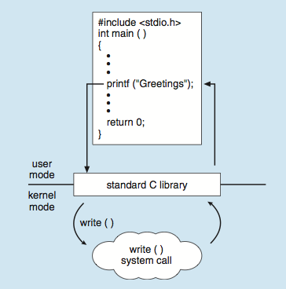
Standard C Library Example
C program invoking printf() library call, which calls write() system call

Slide 16
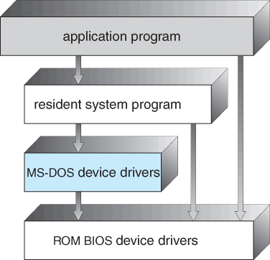
DOS OS architecture - I
Notes:
https://www.tutorialspoint.com/ms-dos-layered-structure#:~:text=MS%2DDOS%20is%20an%20operating,the%20layers%20have%20different%20functionalities.

Slide 17
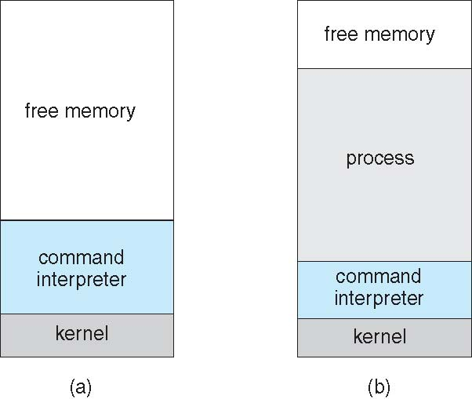
DOS OS architecture - II
Single-tasking
Shell invoked when system booted
Simple method to run program
No process created
Single memory space
Loads program into memory, overwriting all but the kernel
Program exit -> shell reloaded

Slide 18
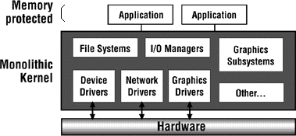
OS architecture
Everything *almost* runs in kernel model
Example: Linux
Pros and Cons

Slide 19
Monolithic OS architecture
Pros: Good performance (Speed) / (Shared kernel space) Simplicity of design
Cons:
No information hiding
Potential stability issues / Chaotic
Hard to understand
Can become huge
Linux 4.15 has 20 million lines of code
Windows 10 contains over 40 million lines!
Potentially difficult to maintain
Examples:
Traditional Unix kernels (includes BSDs and Solaris)
Linux
MS-DOS, Windows 9x
Mac OS versions below 8.6
Notes:
https://www.geeksforgeeks.org/monolithic-kernel-and-key-differences-from-microkernel/

Slide 20
Microkernel architecture
Push stuffs out of kernel
Client-Server model
Example: Mac OS, iPhone OS etc
Pros : Modularity: easier management, Fault isolation and reliability
Cons: Inefficient (boundary crossings); Insufficient protection; Inconvenient to share data between kernel and services

Slide 21
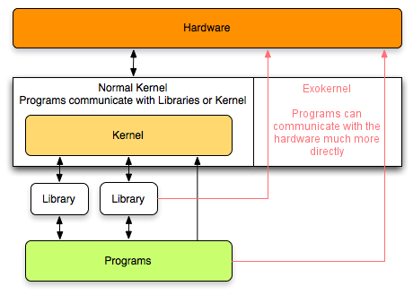
Exokernel architecture
Proposed by MIT
Application-oriented OS
Gives them all control
Research
Notes:
https://www.techopedia.com/definition/27006/exokernel#:~:text=The%20exokernel%20architecture%20is%20built,from%20micro%2D%20and%20monolithic%20kernels.
Exokernel is an operating system developed at the MIT that provides application-level management of hardware resources. This architecture is designed to separate resource protection from management to facilitate application-specific customization.

Slide 22
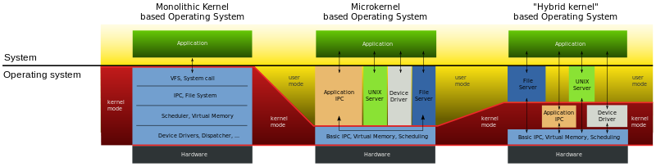
Comparison

Slide 23
Questions
Is the operating system using the CPU at all times?
After booting and initialization, what are the circumstances that would cause OS code to use the CPU?

